Slide 1
Testing Time

Slide 2
Challenges
Add linting to your project
Test suite running with one command
Write a unit test for a function in your code
Write an integration test for a module in your code
Write a test that uses mocks/spies
Refactor a module to make it more testable
Install a code coverage tool
Write a test abstraction
Write a test that incorporates fixture data
Write a stress/performance test
Group tests by category/speed

Slide 3
Examples

Slide 4
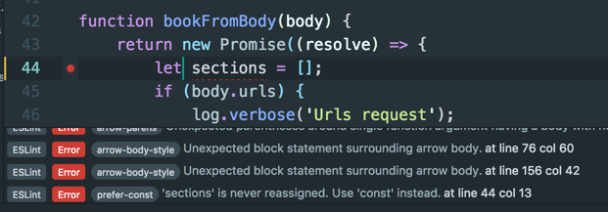
Linting
Enforces a consistent code style.
Catches small bugs and errors as you type.
Example: Eslint

Slide 5
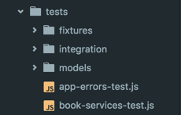
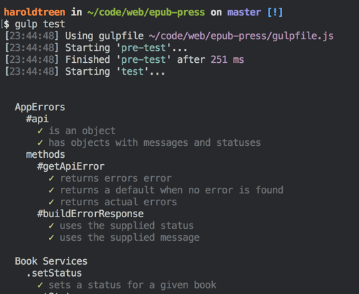
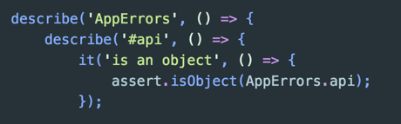
Test suite
Should be easy to run (one command)
Should auto detect new tests/files

Slide 6
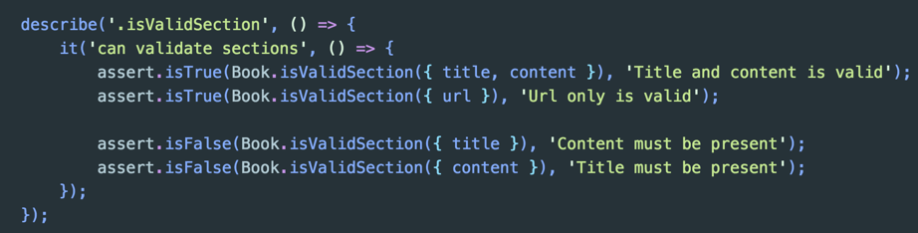

Unit test a function
Functions output only depends on input.
Easy to test due to no external dependencies.

Slide 7
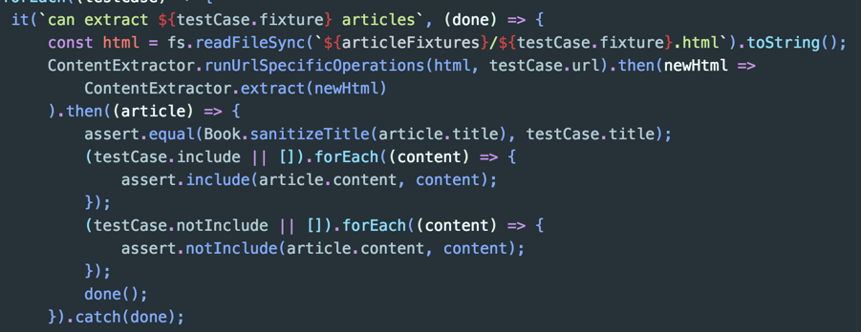
Integration Test
Tests multiple pieces of code working together.
Example: Testing full article extraction code paths.

Slide 8
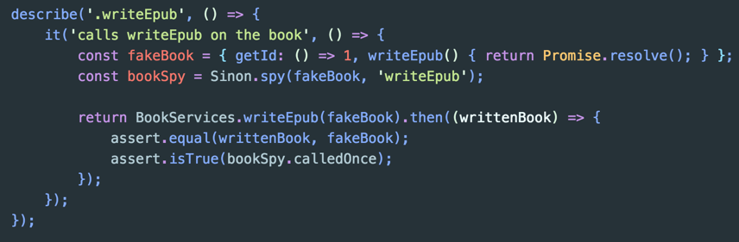
Mocks/Spies/Stubs/Doubles...Oh my!
Allows you to check things deeper in the system.
Ensures consistent conditions for your module under test.
Speeds up tests by skipping expensive computations.

Slide 9
Making Modules More Testable
Modules should know less about the outside world.
Not testable:
Having many external dependencies.
Having internal dependencies that can’t be mocked out.
Testable:
Has few dependencies.
Accepts dependencies as parameters (dependency injection)

Slide 10
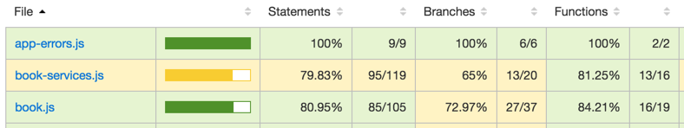
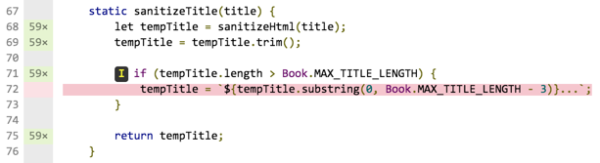
Code Coverage
Inserts extra code to track what lines have been called (instrumenting).
Gives line by line stats on what is being tested.

Slide 11
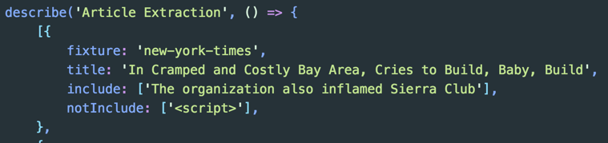

Test Abstractions
Testing functions with a wide range of inputs.
Writing an abstraction lets you add more inputs with little overhead.
Creates consistency in the output.

Slide 12
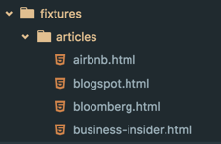
Fixture Data
Sometimes your app needs to accept data from another source.
Rather than request data from that source, save it to a file and load it in your test.

Slide 13
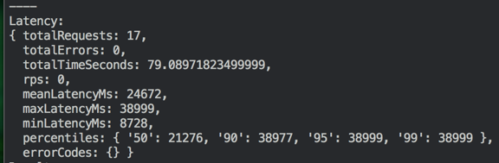
Performance/Stress Testing
Write tests to ensure functions run within a given time limit.
Write tests to ensure your system can withstand heavy usage.

Slide 14




Test Grouping
By grouping tests, you can avoid running tests that are slow/irrelevant to what you’re working on.

Slide 15
1...2...3...Test!

